Slide 1
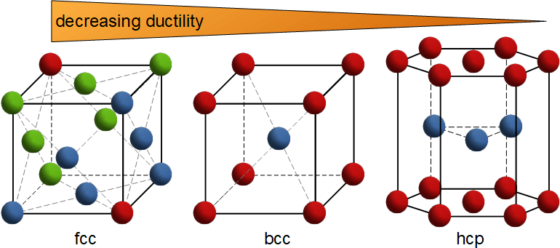
Production drawings, design concepts, material selection Somnath Chattopadhyaya

Slide 2
Learning Objective
Introduction to Materials
Introduction to structure of the materials

Slide 3
Production Drawings
Production drawings (sometimes called working drawings) are complete sets of drawings that detail the manufacturing and assembly of products (as distinct from engineering drawings prepared by and/or for production engineers whose task is to decide how best to manufacture the products).

Slide 4
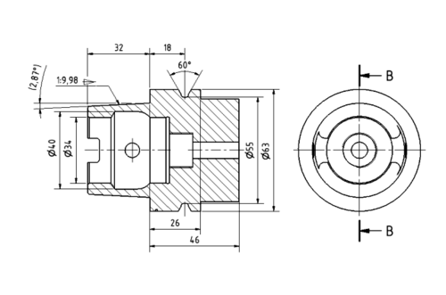
Production Drawings

Slide 5
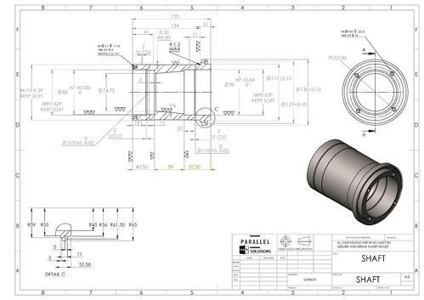
Production Drawings

Slide 6
Design Concept
A design concept is the idea behind a design.
It's how one plans on solving the design problem in front of oneself.
It's the underlying logic, thinking, and reasoning for how one will design a product.

Slide 7
Engineering Materials
This section summarizes how atomic structure, bonding, and crystal structure (or absence thereof) are related to the type of engineering material: metals, ceramics, and polymers.

Slide 8
Engineering Materials
Metals have crystalline structures in the solid state, almost without exception.
The unit cells of these crystal structures are almost always BCC, FCC, or HCP.
The atoms of the metals are held together by metallic bonding, which means that their valence electrons can move about with relative freedom (compared with the other types of atomic and molecular bonding).

Slide 9
Decreasing Ductility

Slide 10
Face-centered-cubic (fcc) configuration
Solid copper can be described as the arrangement of copper atoms in a face-centered-cubic (fcc) configuration. A copper atom is found at each corner and in the center of each face of a cube as depicted in the Figure.

Slide 11
HCP, FCC and BCC structures
The hexagonal closest packed (hcp) has a coordination number of 12 and contains 6 atoms per unit cell.

Slide 12
HCP, FCC and BCC structures
The face-centered cubic (fcc) has a coordination number of 12 and contains 4 atoms per unit cell.
The body-centered cubic (bcc) has a coordination number of 8 and contains 2 atoms per unit cell

Slide 13
Engineering Materials
These structures and bonding generally make the metals strong and hard. Many of the metals are quite ductile (capable of being deformed, which is useful in manufacturing), especially the FCC metals.
Other general properties of metals related to structure and bonding include high electrical and thermal conductivity, opaqueness (impervious to light rays), and reflectivity (capacity to reflect light rays).

Slide 14
Ceramics
Ceramic molecules are characterized by ionic or covalent bonding, or both.
The metallic atoms release or share their outermost electrons to the nonmetallic atoms, and a strong attractive force exists within the molecules.
The general properties that result from these bonding mechanisms include high hardness and stiffness (even at elevated temperatures) and brittleness (no ductility).
The bonding also means that ceramics are electrically insulating (nonconducting), refractory (thermally resistant), and chemically inert.

Slide 15
Ceramics
Ceramics possess either a crystalline or noncrystalline structure. Most ceramics
have a crystal structure, whereas glasses based on silica (SiO2) are amorphous.
In certain cases, either structure can exist in the same ceramic material.
For example, silica occurs in nature as crystalline quartz.

Slide 16
Ceramics
When this mineral is melted and then cooled, it solidifies to form fused silica, which has a noncrystalline structure.

Slide 17
Polymers
Polymers A polymer molecule consists of many repeating mers to form very large molecules held together by covalent bonding.
Elements in polymers are usually carbon plus one or more other elements such as hydrogen, nitrogen, oxygen, and chlorine.
Secondary bonding (van der Waals) holds the molecules together within the aggregate material (intermolecular bonding).
Polymers have either a glassy structure or mixture of glassy and crystalline.

Slide 18
Polymers
There are differences among the three polymer types. In thermoplastic polymers, the molecules consist of long
chains of mers in a linear structure.

Slide 19
Polymers
These materials can be heated and cooled without substantially altering their linear structure.
In thermosetting polymers, the molecules transform into a rigid, three-dimensional structure on cooling from a heated plastic condition.
If thermosetting polymers are reheated, they degrade chemically rather than soften.
Elastomers have large molecules with coiled structures.
The uncoiling and recoiling of the molecules when subjected to stress cycles motivate the aggregate material to exhibit its characteristic elastic behavior.

Slide 20
Polymers
The molecular structure and bonding of polymers provide them with the following typical properties: low density, high electrical resistivity (some polymers are used as insulating materials), and low thermal conductivity.
Strength and stiffness of polymers vary widely.
Some are strong and rigid (although not matching the strength and stiffness of metals or ceramics), whereas others exhibit highly elastic behavior.

Slide 21
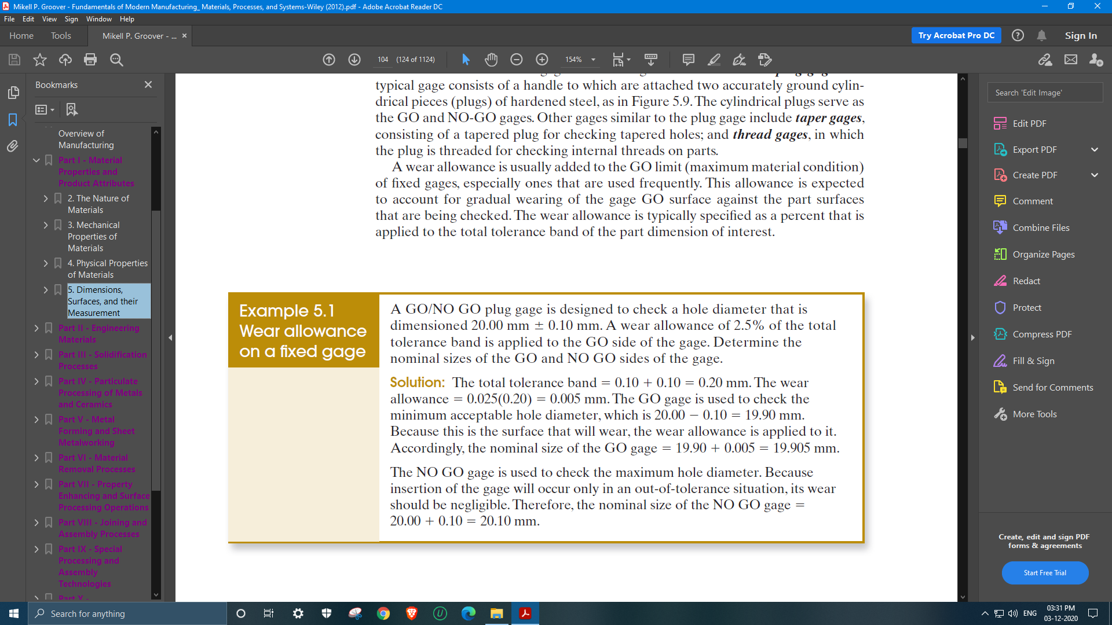
Numerical Problem

Slide 22
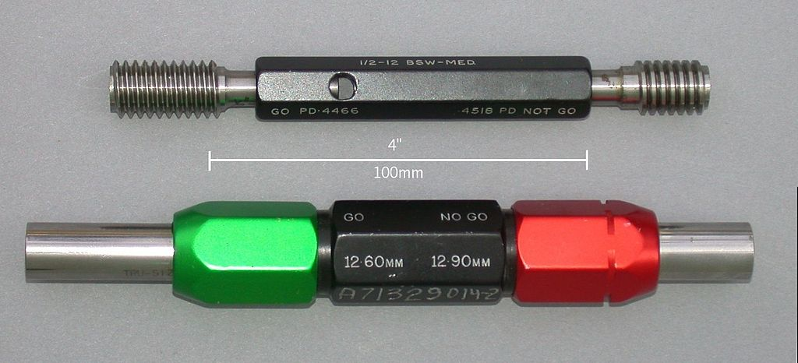
Plug Go Gauge & NOGO Gauge

Slide 23
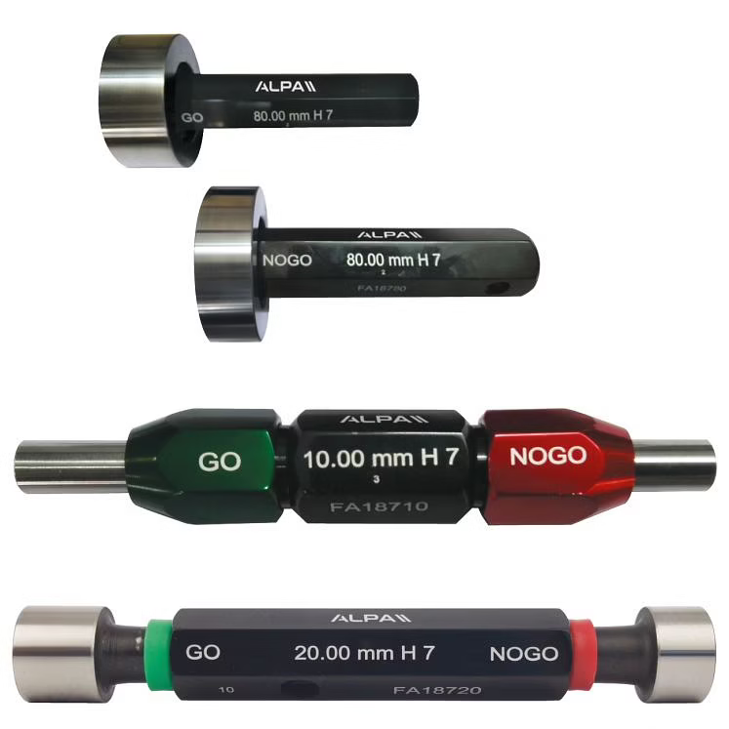
^{Go and NoGo Plug Gauges}

Slide 24
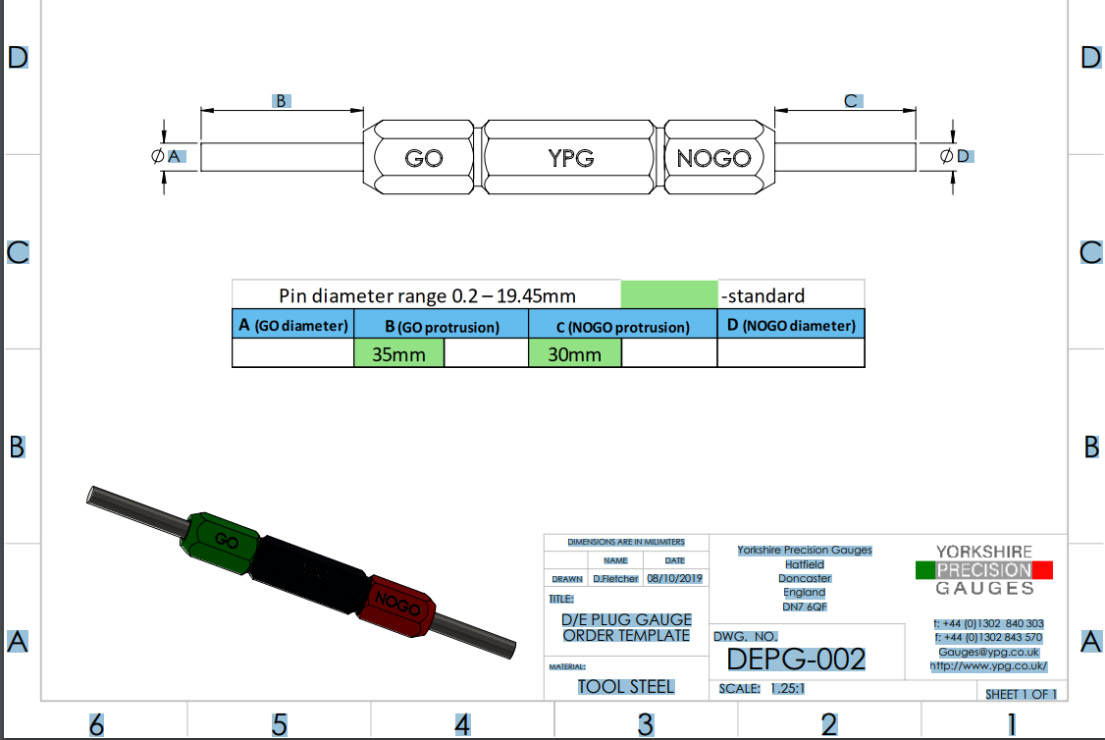
Engineering Drawing of Plug Gauges

Slide 25
Solution

Slide 26
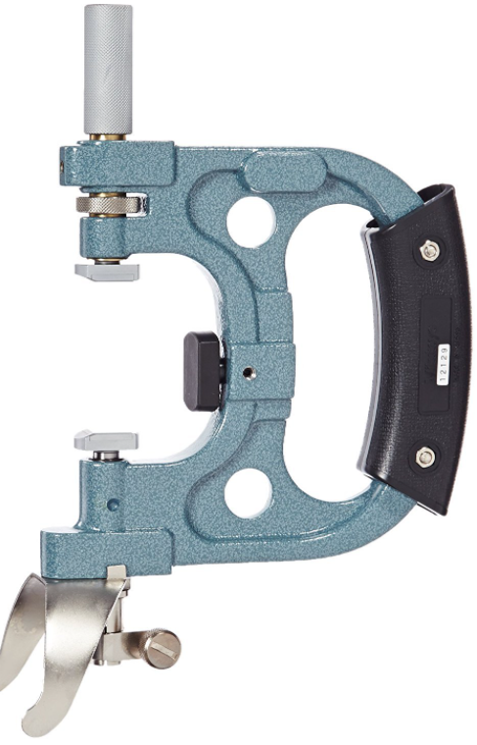
Mitutoyo Snap gauge Rs58,000/-

Slide 27
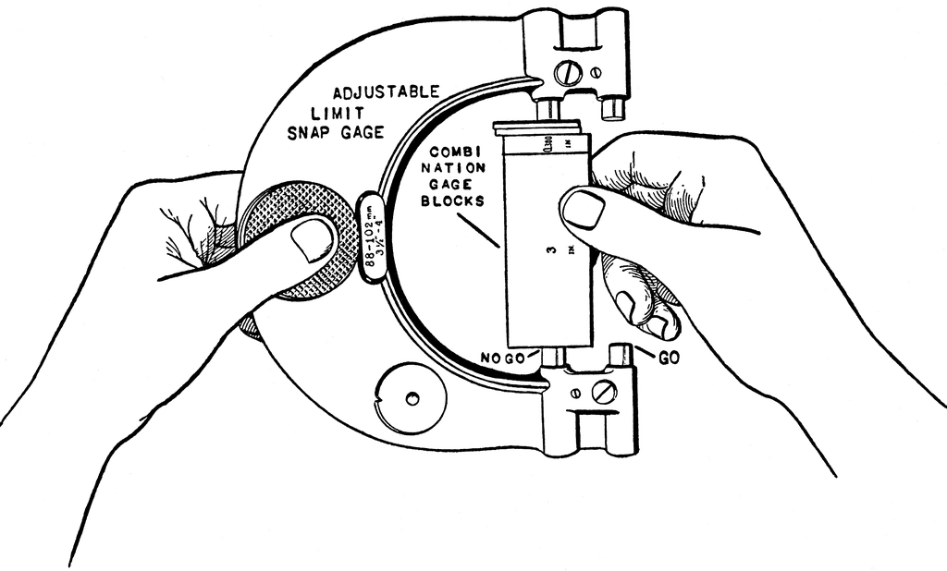
Snap gauge

Slide 28


